Slide 1


Cloud Native Applications
Introducing Continuous Integrat
Notes:
Resting slide on screen before you begin presenting.

Slide 2
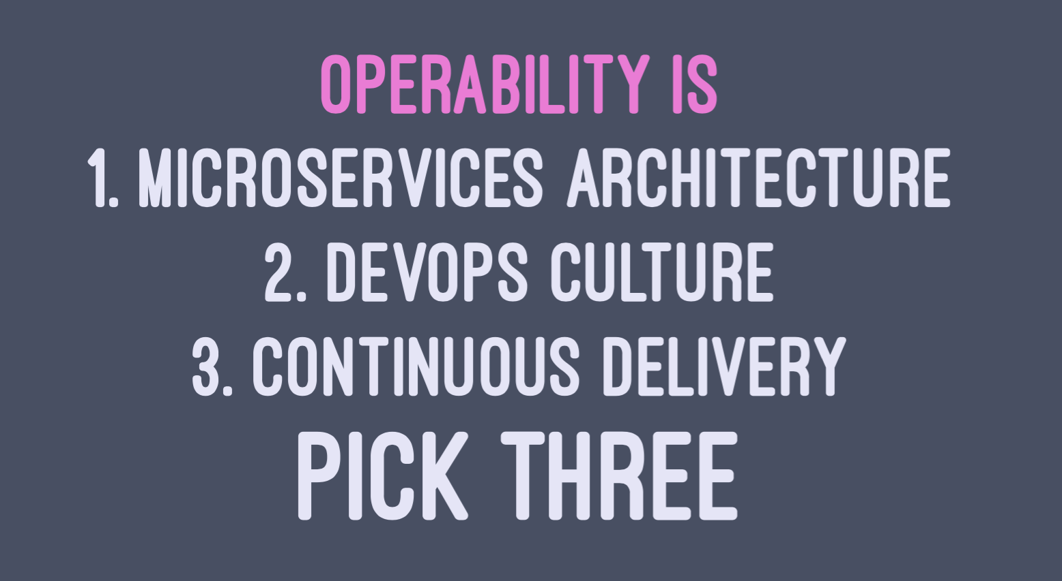
Notes:
If you want to be a digital business, these are the 3 things you must have. Continuous delivery gives your developers a frictionless path production, which means they can deploy new code faster - several times a day even.
https://youtu.be/NYv0kwlkwAY

Slide 3
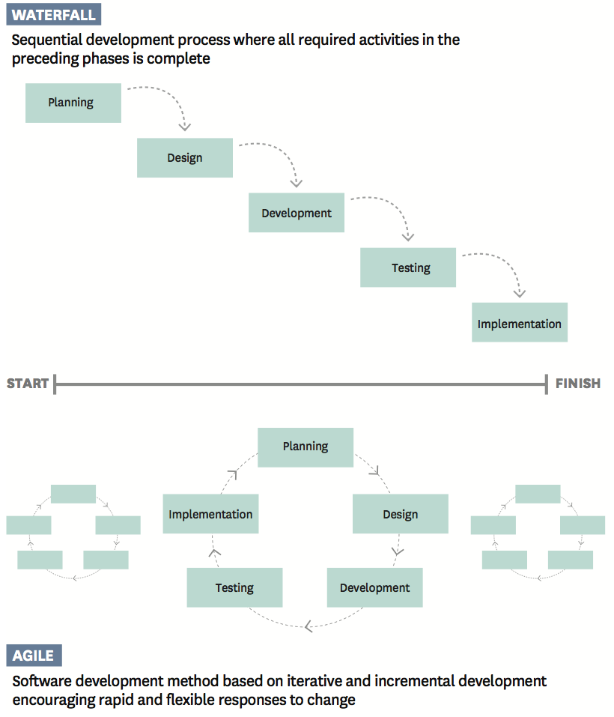
Continuous Delivery
Increasing Throughput with Small Batches
Reduce releases from every 12 months to one week or less
Requires automation in building, testing, and deploying
New tooling and processes needed in dev and production
Source: Agile Practice: the Competitive Advantage for A Digital Age
Notes:
What is continuous delivery?
Reducing the release cycle for software projects down to a week, if not daily. This requires a difference cadence of cycles – smaller batches of code – but enables faster thru-put on features, better quality (you can fix bugs easier and faster), and improved product features (because you get a faster feedback loop on which features work well and how they can be improved). Being able to release “at any time” requires changes to tooling and process from the traditional 6-12 month cycle.

Slide 4
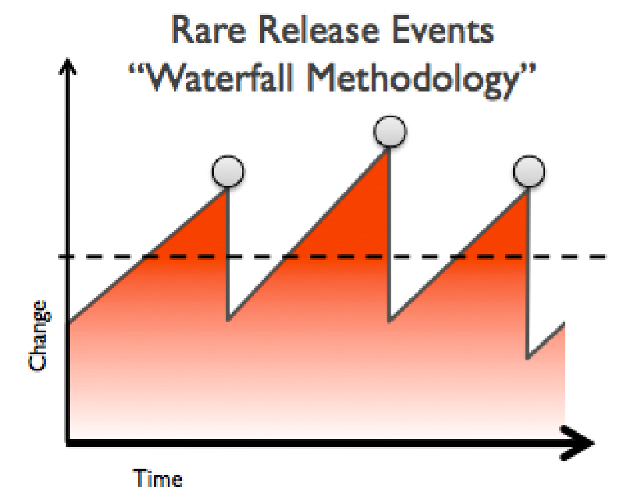
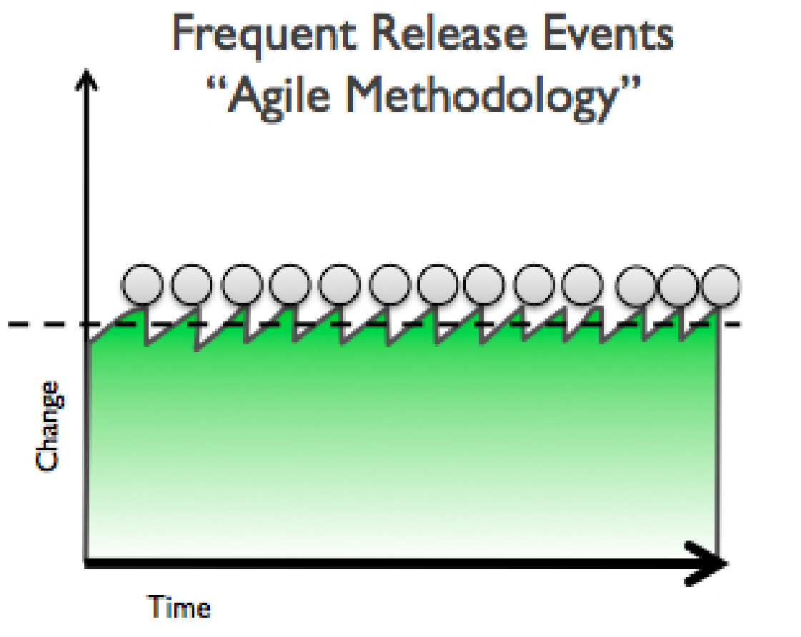
Use Speed as a Competitive Weapon
Increasing Throughput with Small Batches
Good for innovation-driven projects that must continually improve
Increases speed & quality by shifting to smaller batches, while reducing risk
Frequent releases increases the amount of feedback used for product management
Notes:
Why does it matter to customers?
Tighter loops are good for innovation. It gives you more feedback and lets you explore, learn, and try out more things while controlling risk. These smaller loops can also just increase quality (finding defects in smaller batches of code is easier than larger batches of code, reducing risk), but that’s only part of the story Full value requires using the opportunity given by smaller loops to incrementally improve the product in week (or whatever the release period is) cycles instead of the traditionally long cycles of 6 to 12 months.

Slide 5
7 Prerequisites for Continuous Delivery
DevOps culture
Continuous Integration
Automate and version tasks, for auditing & reproduction
Shared tools & procedures
Apps must be easy to deploy to prod & easy to rollback
App must be deployed to programmable target
Application versions must be ready to be shipped into production
Source: Pre-requisites for a successful enterprise Continuous Delivery implementation
Notes:
DevOps culture
Commitment to shared goals for Dev, Ops, QA
Continuous Integration
Source control management, automated builds & unit tests, continuous builds of the software
Automate and version tasks, for auditing & reproduction
Building apps/packages, deploying config, resetting environments
Shared tools & procedures
Across teams and environments (dev/test/prod)
Apps must be easy to deploy to prod & easy to rollback
Deployments must be non-events
App must be deployed to programmable target
Like public cloud or cloud-native platform
Application versions must be ready to be shipped into production
Deploy any version that passes through the CD pipeline, not just a specific version number

Slide 6
Platform Support for CD Processes
Baseline environments consistent
Inject environment-specific config and external dependencies
Consistent API across environments and operations
Promote apps with same process
Support for advanced operations
Production
Staging
Integration
Development
Instant App Environment
Automated Deployment
Autoscaling
A/B Testing
Canary / Zero Downtime Deployment
Notes:
Cloud Foundry as a Platform offers services & features that inherently complement & facilitate CI/CD. You can contrast this to using VMs as the target environment for CI/CD.
App Developers + Agile Infrastructure = More Successful Outcomes
Platform helps CI/CD in the following ways:
Get A New App Environment In Seconds
Have Complete Consistency Between Environments
Have A Consistent API To Automate Deployments
Inject Environment Specific Configuration
Inject External Dependencies
Promote Apps Through Environments With The Same Process
By Providing New Options:
•Canary Deployment
•Zero Downtime Deployment
•A/B Testing
•Scale Apps On-Demand

Slide 7


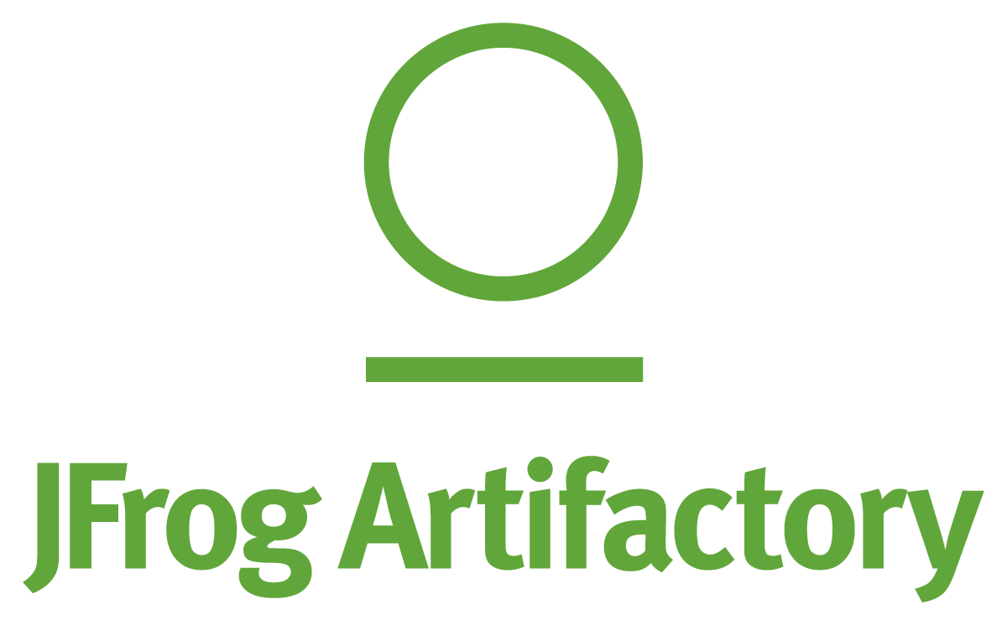
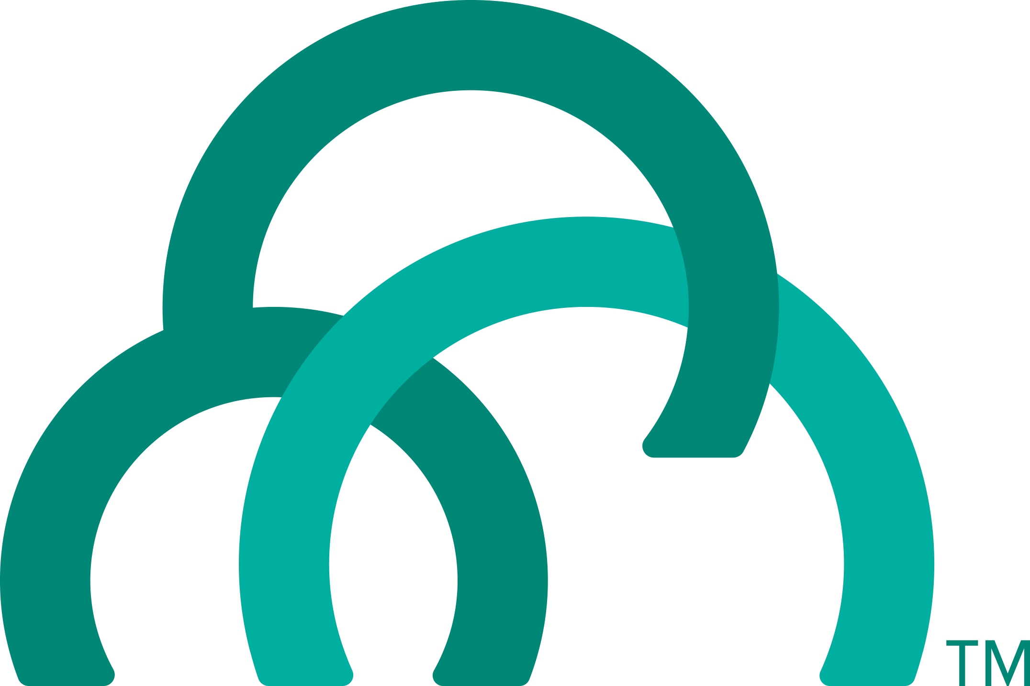
Continuous Integration & Delivery
Deliver High Quality Software Faster & Continuously, from Idea to Production
AUTOMATION.
Integrate tools and automate processes from testing to builds and deployment
SPEED.
Release more frequently with smaller bits will reduce complexity and improve time-to-market
QUALITY.
Reduce feedback loop using test-driven development to surface problems sooner and be responsive
AGILITY.
Push updates on regular basis with no downtime to improve customer experience and time to market
Commit Code Change
Automate Build & Test
(Unit Test, Static Code Analysis)
Store Binaries & Build Artifacts
Automated Integration Testing
Acceptance, Performance & Load
Zero Downtime Upgrade to Production
Build Pipeline Operations
Tool Chain
GitlLab
Concourse
jFrog
Development
Test + UAT + Staging
Production
Distributed revision control and source code management. Collaborative software development
Build and test software projects continuously and incrementally. Hundreds of compatible plugins
Share binaries and manage distributions. Manage artifact lifecycle. Avoid license violations
Develop, test, QA and production on the same platform. Simple, developer friendly commands and APIs. Operational benefits for every app. Built-in ecosystem services. Deploy, operate and scale on any IAAS
Notes:
Continuous delivery is key to iterative development process and CI/CD tools provide the framework for delivery process with transparency between Dev and Ops.
First platform built assuming CD as the prime directive. The platform integrates tools and automates processes for full app lifecycle from testing to builds and deployment
It provides a
consistent API to automate deployments,
standard tooling for all apps with
Commits from many teams rolling into production hosted env as fast as possible with safety
GitLab, Concourse/Jenkins and Artifactory can also be installed on and managed by Pivotal Cloud Foundry, which makes it even quicker and easier to get these platforms up and running.
-------------------Notes on the partner and SCS products for in case of further discussion-------------------
Gitab - Source control product using GIT that includes git repository management, code reviews, issue tracking, wikis , etc. We provide a managed solution, including automated deployment, configuration, scaling & upgrade (via Ops Manager) with persisted data and configuration. Not required to be an expert in Git.
Jenkins - #1 CI tool, 8 years old. Includes the core open source Jenkins technology with advanced enterprise features developed by CloudBees. CB provides professional technical support for Jenkins and 1000+ open source community Jenkins plugins. One click install and scale w/ PCF Ops manager, integrated authentication with PCF UAA to provide single sign-on and support for role-based authentication and authorization
JFrog artifactory - Automate all aspects of artifact management using REST API. Powerful enterprise features and fine grained permissions. Advanced security and reliability features control access to artifacts, where they’re deployed and supports large load bursts with extremely high concurrency+data integrity. Can serve as internal & private docker registry access. Push button deployment , automated upgrades via PCF Ops Manager, with persisted data and configuration. Not required to be an expert in JFrog Artifactory.

Slide 8
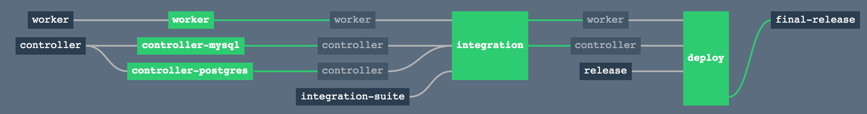
Concourse: Continuous Integration & Delivery
Benefits
AUTOMATION.
Integrate tools and automate processes from testing to builds and deployment
SPEED.
Release more frequently with smaller bits will reduce complexity and improve time-to-market
QUALITY.
Reduce feedback loop using test-driven development to surface problems sooner and be responsive
AGILITY.
Push updates on regular basis with no downtime to improve customer experience and time to market
Concepts
Commit Code Change
Automate Build & Test
Store Binaries & Build Artifacts
Automated Integration Testing
Acceptance, Performance & Load
Zero Downtime Upgrade to Production
Pipeline
Notes:
Continuous Integration (CI) is a development practice that requires developers to integrate code into a shared repository several times a day. Each check-in is then verified by an automated build, allowing teams to detect problems early.
Continuous Delivery is the natural extension of Continuous Integration: an approach in which teams ensure that every change to the system is releasable, and that we can release any version at the push of a button. Continuous Delivery aims to make releases boring, so we can deliver frequently and get fast feedback on what users care about.
Concourse enables CI/CD by realizing the conceptual delivery model in visual pipelines.

Slide 9
Why Concourse
Pipeline-first
Declarative CI (no more snowflakes)
Config stored in version control
Unpolluted Builds
Previous builds do not affect subsequent builds
Environment Parity
Run tasks locally before committing
Usability
Visualize pipeline
Simple UI (click less!)
Scalability
Scale up to increase
Scale down to decrease cost
Notes:
http://concourse.ci/concourse-vs.html

Slide 10
Resources
Continuous Deployment From GitHub To PWS Via Concourse
Concourse Documentation
Continuous Delivery Among the Donkeys
Five Stages of Cloud Native [Video]
How Cloud Foundry is CI’d
Using Concourse to CD a Java app on PCF & Azure
Notes:
http://concourse.ci/concourse-vs.html

Slide 11
Spring Cloud Pipelines
Opinionated deployment pipeline template
Based on good practices from different projects
“Infrastructure as Code” approach
No clicking around to create jobs
Notes:
opinionated template of a deployment pipeline
based on good practices from different projects
we believe in the “Infrastructure as Code” approach
live documentation of the infrastructure
in case of automation server going down you can recover everything in no
time
the automation server setup should be automated too!
you can even write tests for your pipelines
no more clicking of jobs manually!

Slide 12
Spring Cloud Pipelines
Automation server support:
Concourse
Jenkins
Build system support:
Maven
Gradle
Steps implemented in bash scripts
Notes:
we support following automation servers out of the box
Concourse
Jenkins using Jenkins Job DSL plugin
Jenkins using Jenkinsfile with Blue Ocean
Logic implemented in Bash scripts:
Convert the internals to suit your needs
you can use whatever automation server you want
supports Maven & Gradle

Slide 13
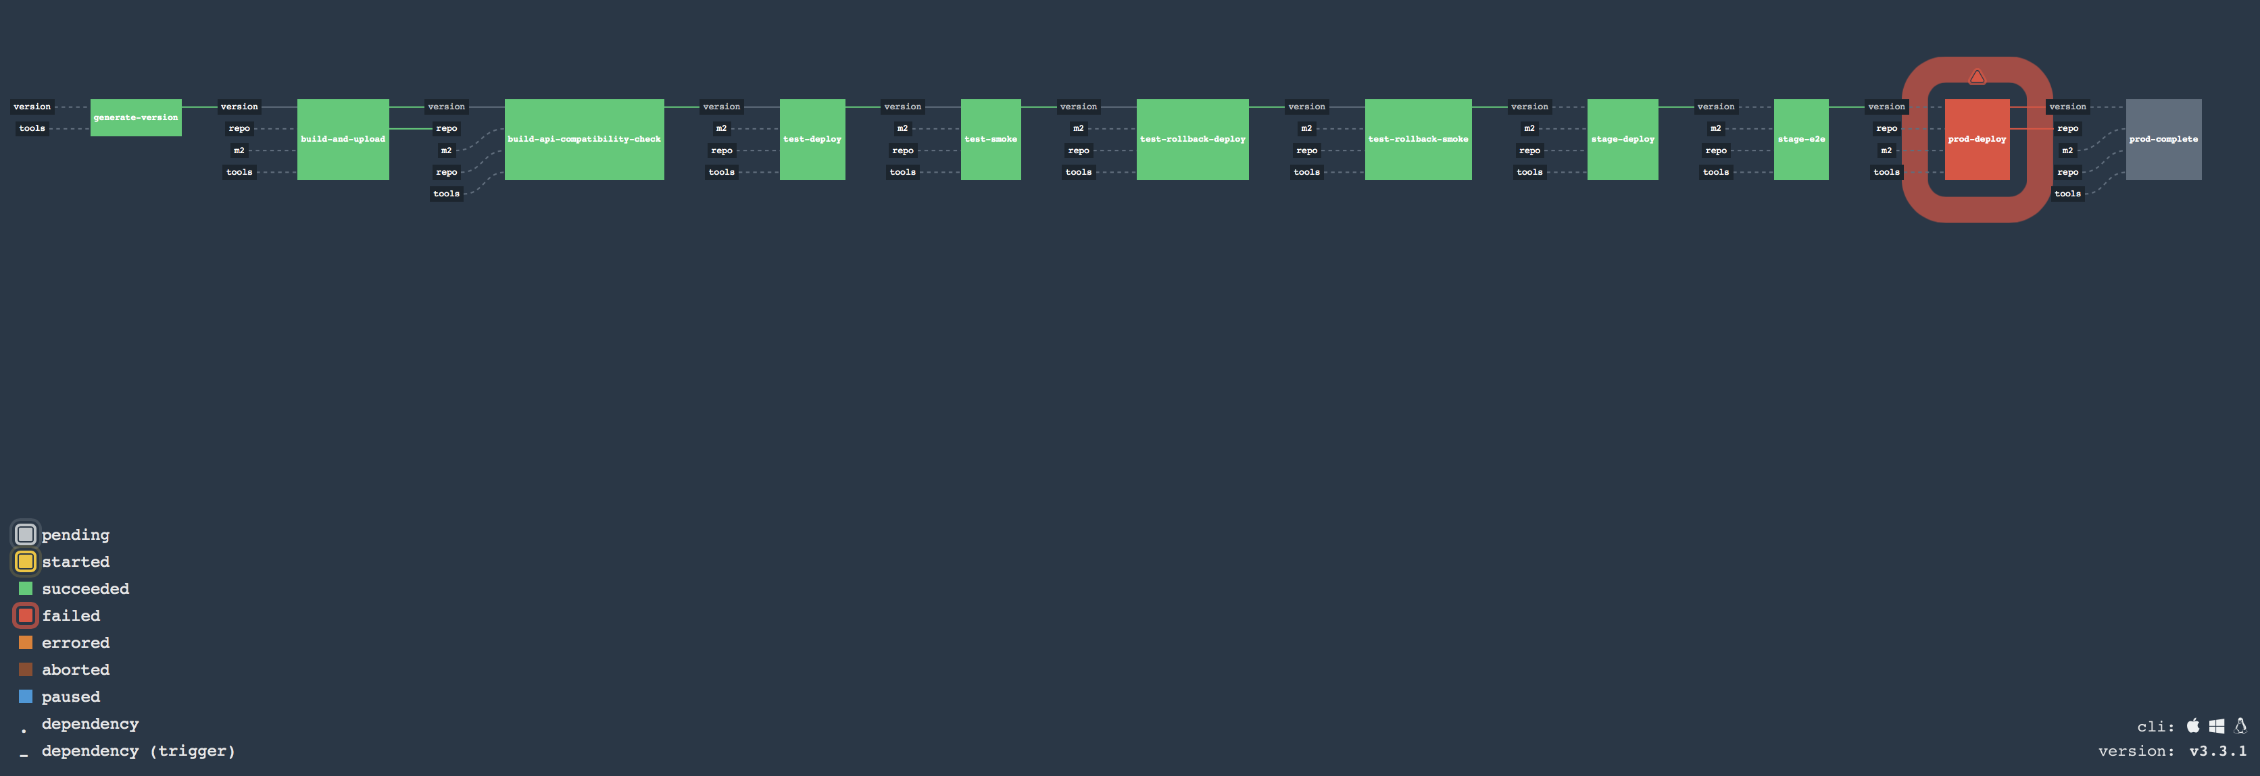
Spring Cloud Pipelines - Concourse

Slide 14
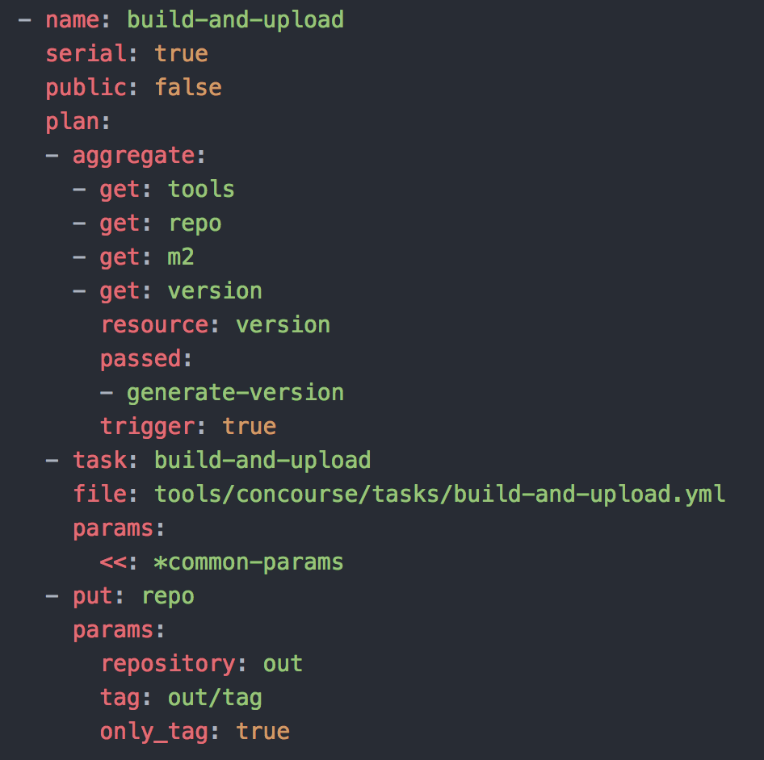
Spring Cloud Pipelines - Concourse

Slide 15
Spring Cloud Pipelines
Demo

Slide 16
Spring Cloud Pipelines - Summary
Continuous Deployment allows you to continuously deliver business value
OOB tooling to test your software:
Unit and integration testing
Contract testing
Rollback testing
Easily adjust the deployment pipeline to suit your needs
In conjunction with PCF you can do A/B & zero downtime deployment

Slide 17
Appendix: Gitlab + JFrog Overview
Notes:
We mentioned a few 3rd parties, here’s more information on each if needed.

Slide 18
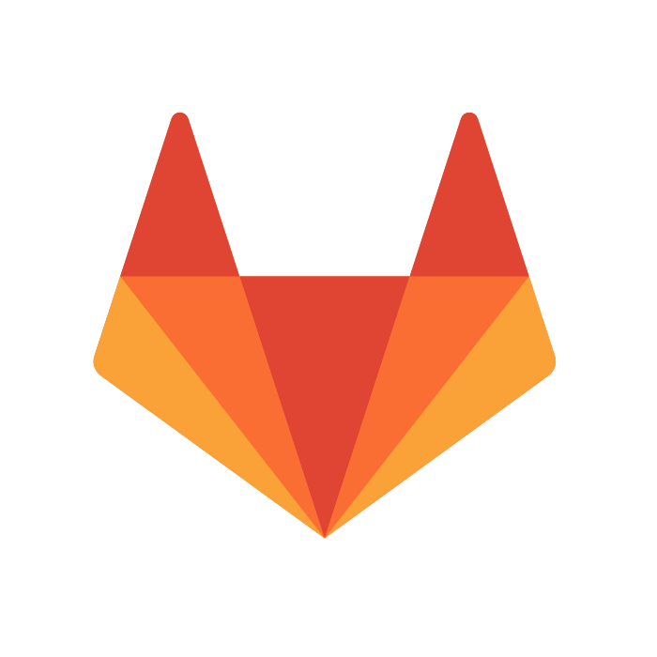
Source Code Repository: Git with GitLab

Slide 19
What is GitLab?
Source control product using git
Includes git repository management, code reviews, issue tracking, wikis and much more
Provides a managed solution, including automated deployment, configuration, scaling and upgrade

Slide 20
Benefits of GitLab for PCF
For developers
Access to a managed git repository
Powerful web interface that supports the developer workflow
Intuitive pull requests, code review and commenting functionality
Supports inner sourcing
For operators
Push button deployment of a managed git solution
Automated upgrades of software components and GitLab through Ops Manager, with persisted data and configuration
Not required to be an expert in Git to cater for Day 2 operations

Slide 21
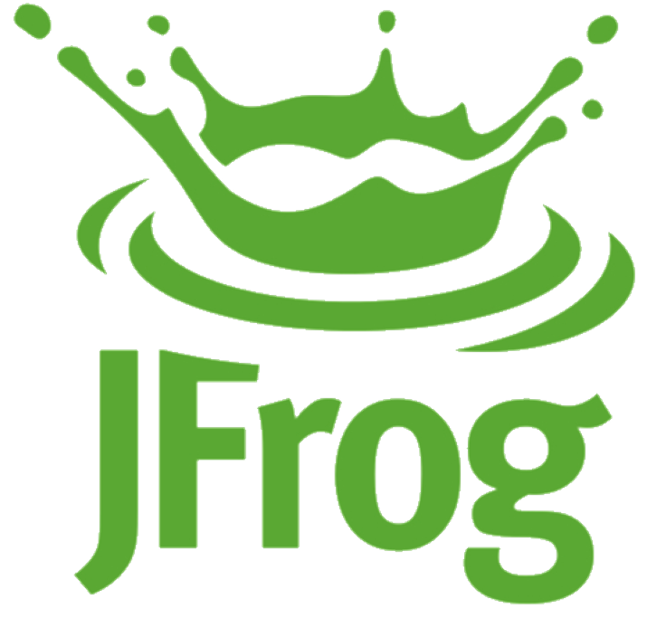
Artifact Repository: Artifactory by JFrog

Slide 22
What is JFrog Artifactory?
An advanced repository manager and a complete platform for automated software package management from development to distribution
Reliable. Artifactory guarantees consistent access to the components needed by your build tools
Efficient. Remote artifacts are cached locally for reuse; they do not need to be re-downloaded over and over
Secure. Fine-grained permissions and roles govern who can deploy what, and where
Scalable. Handles large load bursts with extremely high concurrency and data integrity
Programmable. Automate with REST APIs

Slide 23
Benefits of JFrog Artifactory for PCF
For developers
Access to a powerful artifact repository
Internal & Private Docker Registry access
Powerful web interface that supports the developer workflow
For operators
Push button deployment of a managed artifact repository solution
Automated upgrades of software components and JFrog Artifactory through Ops Manager, with persisted data and configuration
Not required to be an expert in JFrog Artifactory to cater for Day 2 operations

Slide 24
Questions?
Notes:
Questions?

